Slide 1
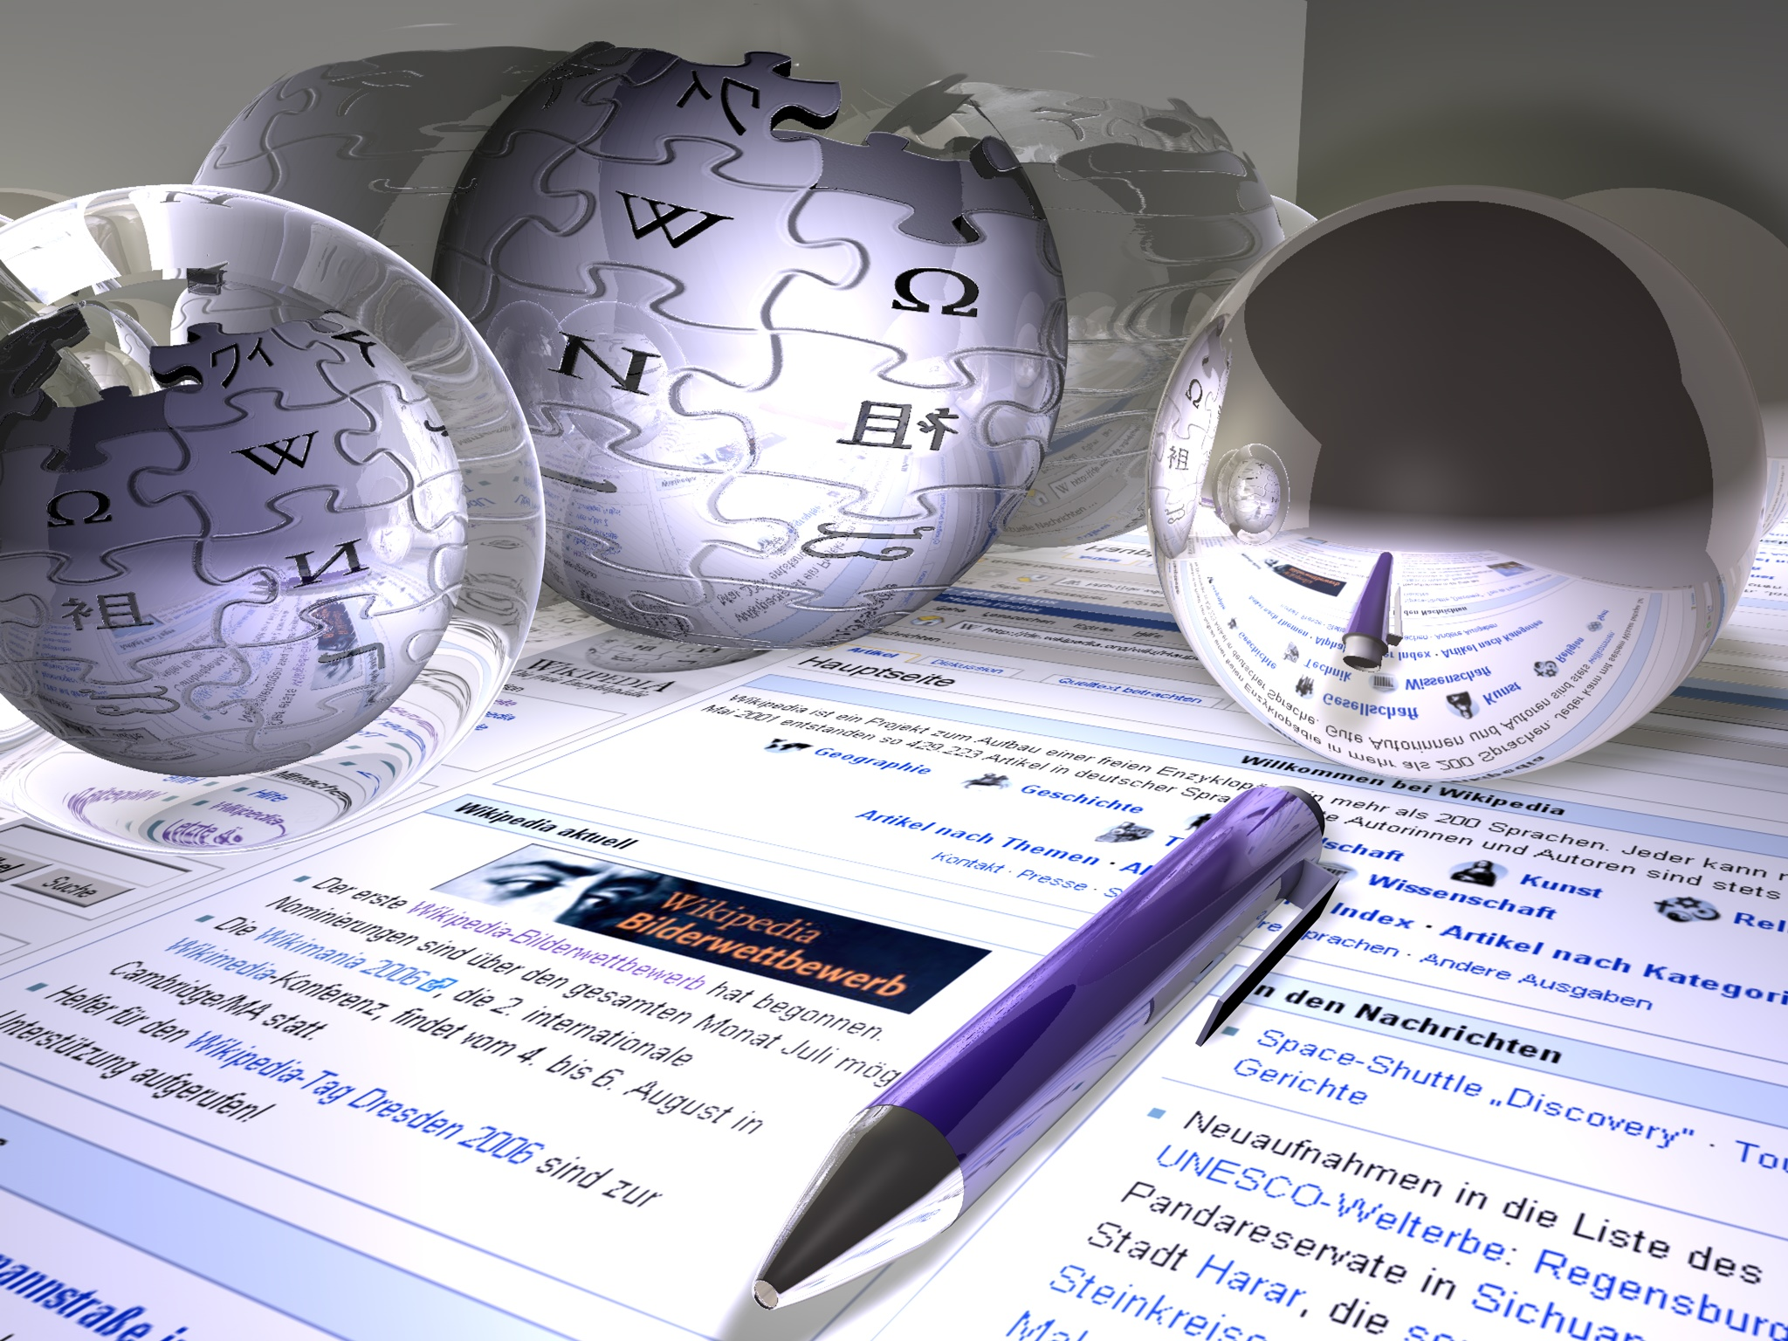
Mass Media

Slide 2

Mass Media
News is not what happens – it is what you see, listen or read in Mass Media.

Slide 3
Mass Media
Newspapers
Television
The Internet
Radio

Slide 4
Answer the questions.
Do the mass media play an important role in our life?
Do you agree that most news we get from the mass media is bad news?
Do you think that journalists are given too much freedom?
What is the main advantage of TV?
What is one of disadvantage of newspapers?
Is the Internet an important source of information?

Slide 5
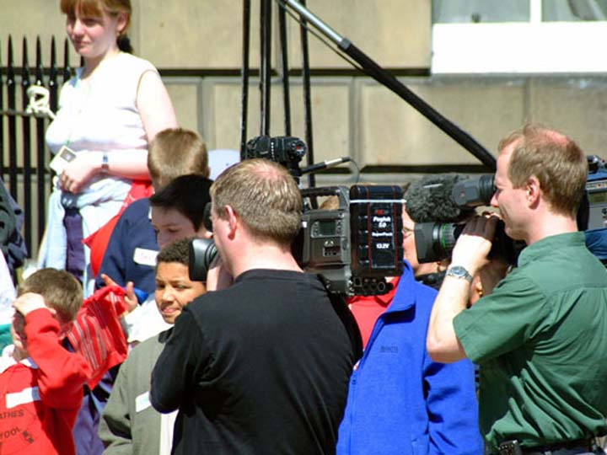
Television

Slide 6
Television in Russia
TNT
The first TV Channel
NTV
Russia
STS
Discovery
SPORTS

Slide 7
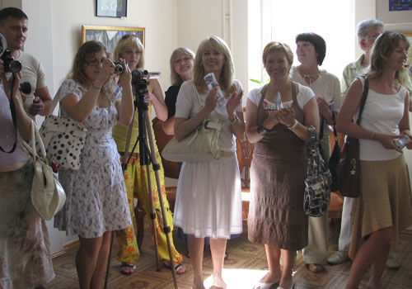
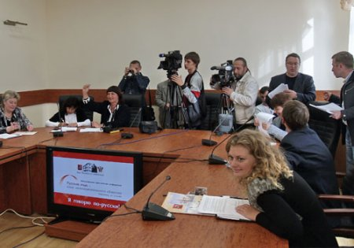
The work of journalists

Slide 8
Television in Great Britain
BBC 1
Channel 4
ITV
BBC 2

Slide 9
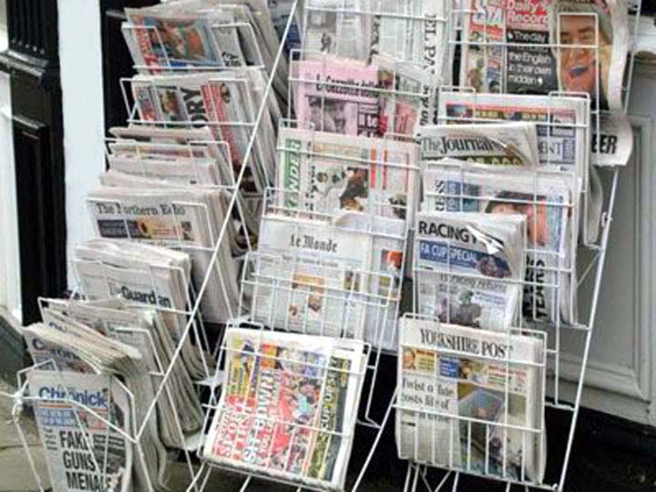
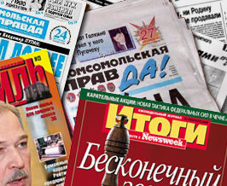
Newspapers

Slide 10
Newspapers in Russia
“Rossiiskaya gazeta”
“Komsomolskaya Pravda”
“Segodnya”
“Nezavisimaya Gazeta”
“Moskovsky komsomolets”
“Argumenti I fakti”
“Express gazeta”
“Okna”
“Zheltaya gazeta”

Slide 11
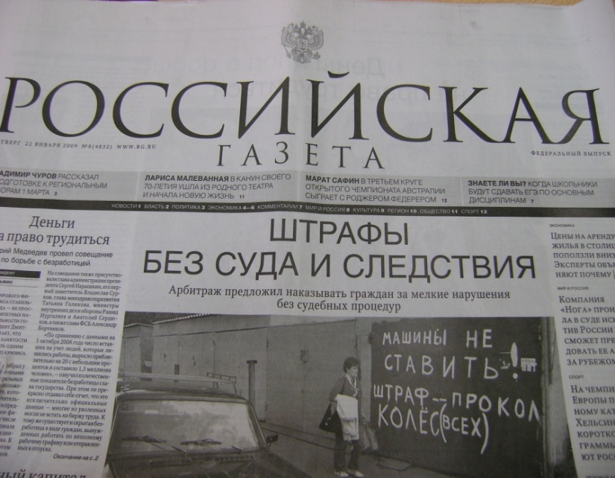
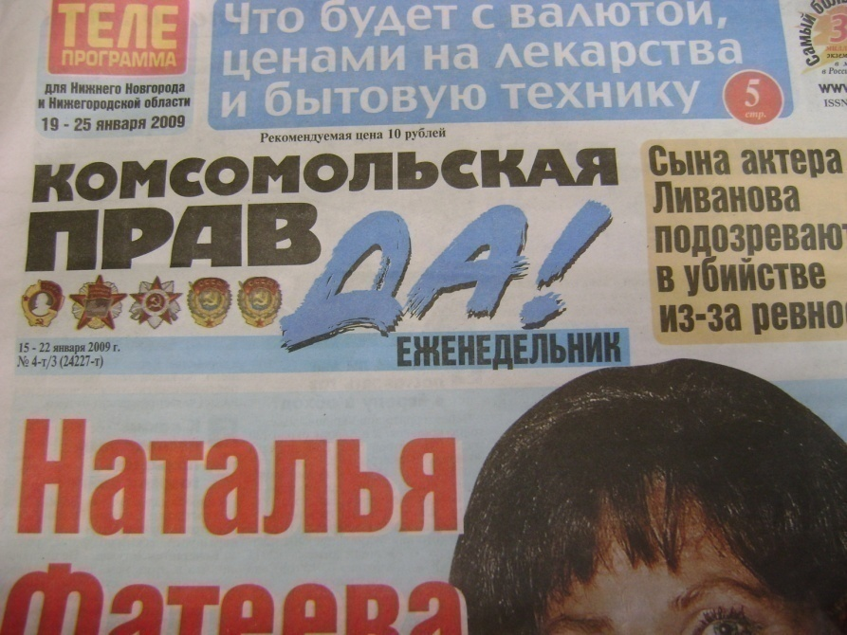
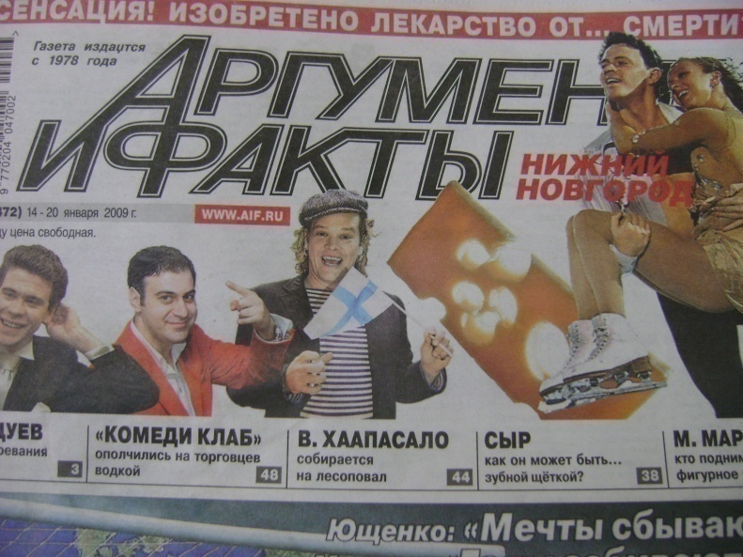
Newspapers in Russia

Slide 12
Newspapers in Great Britain
“The Daily Mail”
“The Sun”
“The Daily Express”
“The Daily Mirror”
“The Daily Star”
“The Times”
“The Independent”
“The Financial Times”

Slide 13

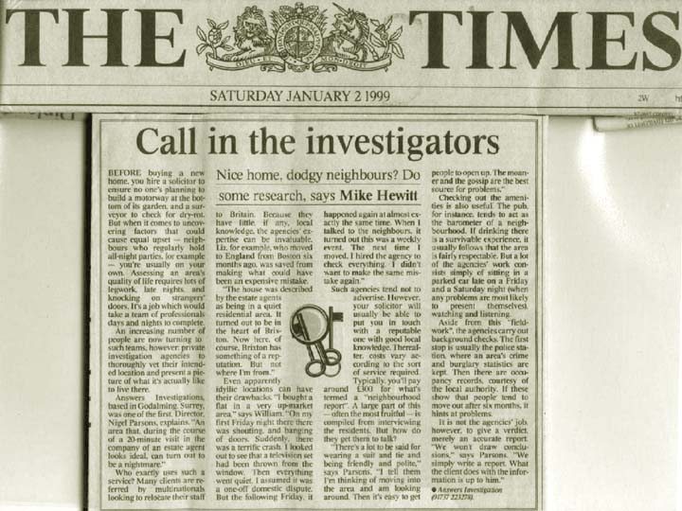
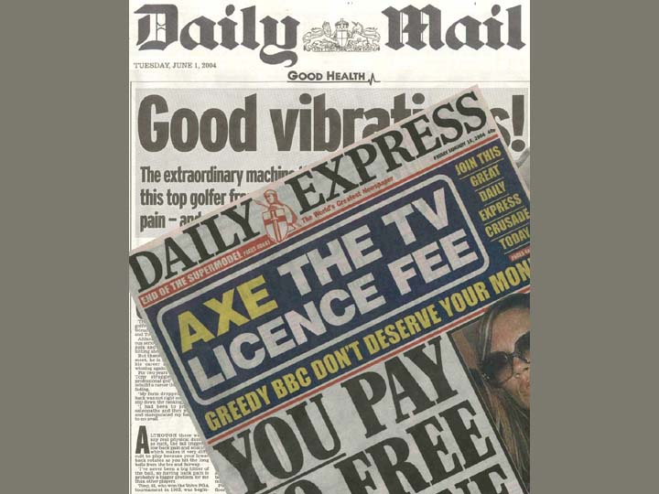
Newspapers in Great Britain
Broadsheets
Tabloids

Slide 14
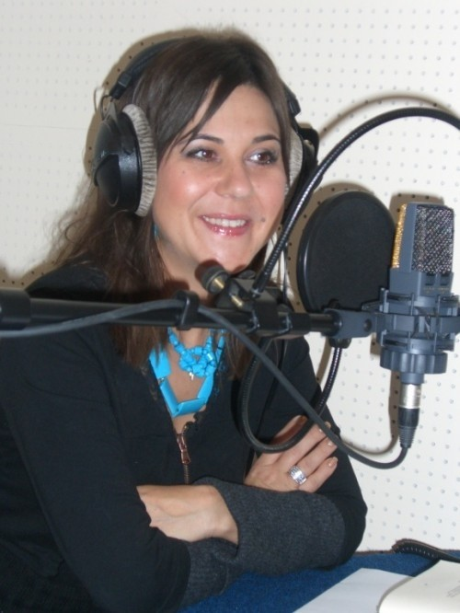
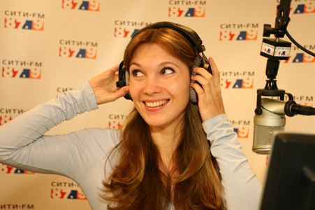
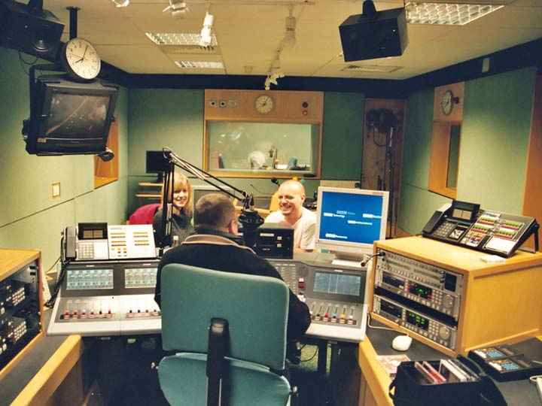
Radio

Slide 15

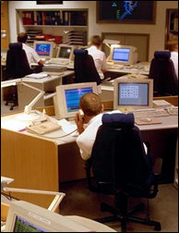
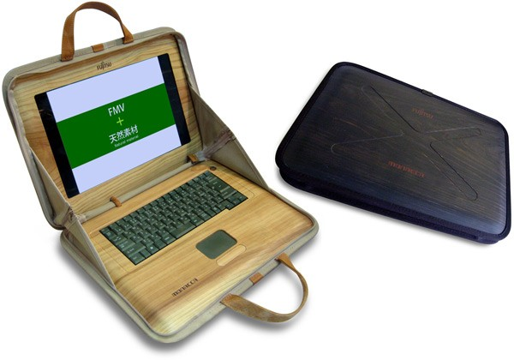
The Internet

Slide 16
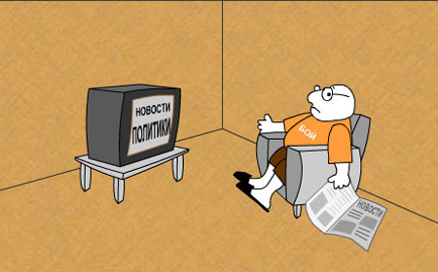
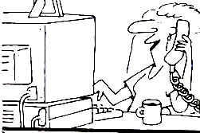
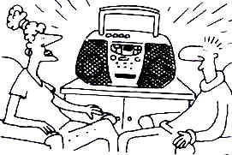
Comment on one of the following pictures .

Slide 17
Make up the dialogues on the topic “Mass Media” using some of the following sentences.
I watch TV every day.
Television informs and entertains me.
Sometimes I listen to the radio when I drive a car.
Most of all I like to read tabloids.
Popular newspapers include the stories about pop-singers. I like it.
The Internet is a source of information.
- The Internet gives me the opportunity to communicate with my friends who live far from our town.

Slide 18
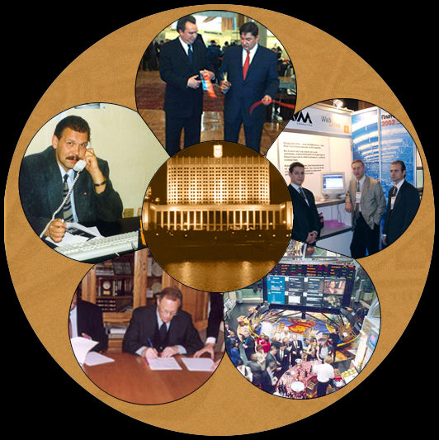
Mass Media
He who owns the information, he owns the world

Slide 19
Thank you very much

